Slide 1
GENERATION XTREME HEALTH AND FIGHT CLUB
COMPANY PROFILE

Slide 2
Generation xtreme
Located at Dubai, Sheikh Zayed road, 3 interchange
Al Joud Center Showroom #13-14 Behind ACE hardware

Slide 3
Generation xtreme health and fight club
Generation Xtreme health and fight club was established in 2010. This is a young club specialized in professional boxing and different styles of martial Arts. Our trainers are professional, former and current world class champions. We are not just a fitness gym but we are real specialized club in training class like boxing, kickboxing, muay thai, jiu jitsu, mix martial arts (MMA), and ultimate fighting.
Our class format is structural and disciplined in a non threatening environment. Our students learn fighting techniques which increase their confidence to defend themselves as well as improve their body control.
We offer various classes for men, women, and kids from 4 years of age. Generation Xtreme health and fight club is a club catering for everyone. Fitness gym facilities are also available

Slide 4
Group Classes
Muay thai
Jiu Jitsu
Boxing
Kickboxing
Mix Martial Arts
Capoeira

Slide 5
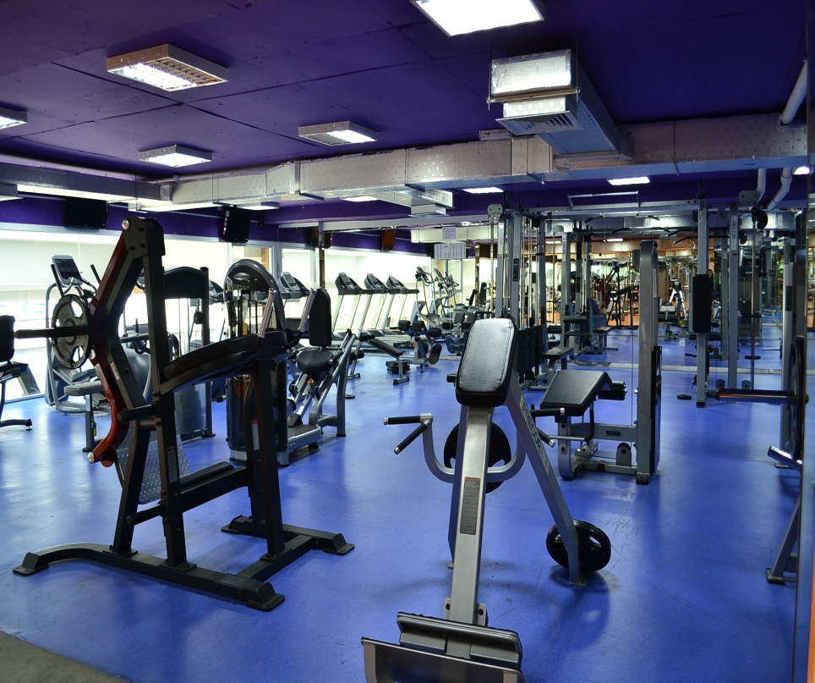
Gym facilities

Slide 6
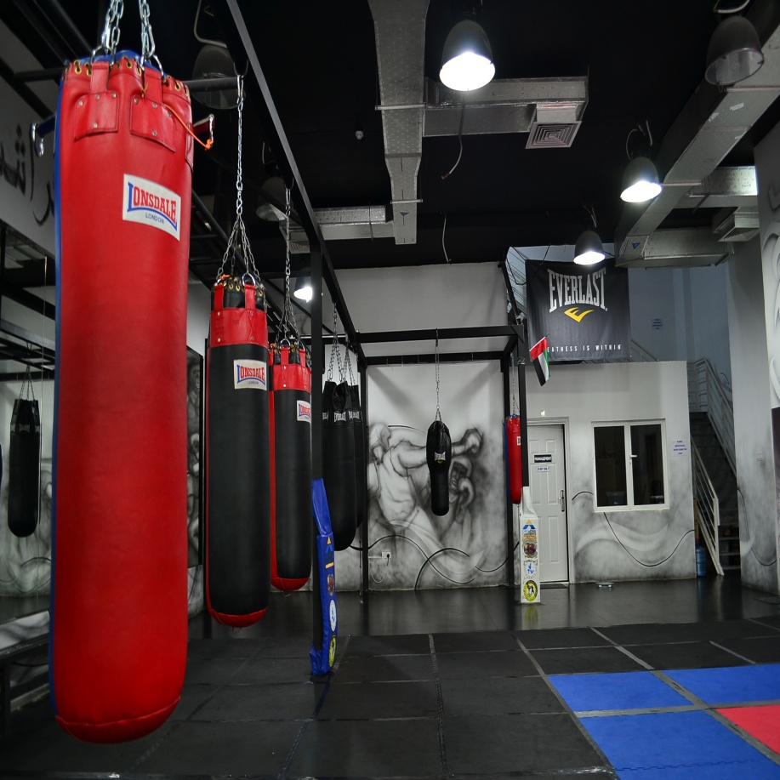
Mix martial arts facilities

